Slide 1
Personal and Professional Effectiveness

Slide 2
Outline
Defining Effectiveness
Effectiveness and Efficiency
Effectiveness and Goal Setting
Areas of Effectiveness
80/20 Principle
Mastery and 10,000 Hours Principle
The Power of Habits
Making Effectiveness as Part of Our Life

Slide 3

Defining Effectiveness

Slide 4
Effectiveness
Capability to produce a desired result.
Achieving the right/desired goals.
Getting the right things done.
Questions to ponder!
Who/what defines right or wrong?
What is meant by “desired”?

Slide 5
Effectiveness Vs Efficiency
Efficiency = output/input
The comparison of what is actually produced or performed with what can be achieved with the same consumption of resources (money, time, labor, etc.). It is an important factor in determination of productivity.
Relation between effectiveness and efficiency.
Doing the right things and doing things the right way.

Slide 6
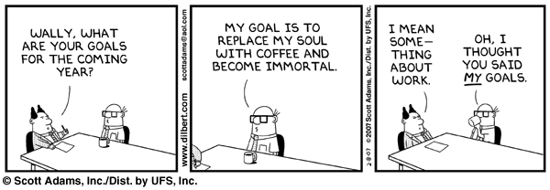
Goal Setting

Slide 7
Goal Setting
Short term and long term goals
Interconnectedness of goals
Stretch goals
Power of visualization
Fear of failure and fear of success

Slide 8
Areas of Effectiveness
Social
Interpersonal
Physical
Psychological
Cognitive
Professional
Spiritual
Financial

Slide 9
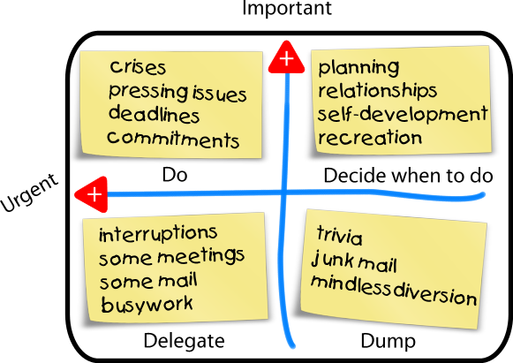
Urgency Vs Importance

Slide 10
The 80/20 Principle
Pareto Principle
Prioritizing
Focusing on key areas
Dominos effect

Slide 11
The Power of Habits
a settled or regular tendency or practice, especially one that is hard to give up.
Positive and negative habits
The habit loop – cue, behaviour and the reward
10,000 hours rule

Slide 12
Making Effectiveness Part of our Lives
Aiming for incremental changes.
Being mindful
Bending the rules Vs Breaking them
Pushing our limits Vs letting it go

Slide 13


